Slide 1
EVOTEKARO

Slide 2
TEAM MEMBERS
Frontend developers
Backend developers
Testers
App Dev
KOMAL KRISHNA
2021BCY0038
ADITYA KUMAR RAUSHAN
2021BCY0042
ADITYA KUMAR RAUSHAN
2021BCY0042
AKHILESH
2021BCY0033
ADITYA KUMAR RAUSHAN
2021BCY0010
GANESH PATIL
2021BCY0010
ROHITH
2021BCY0001

Slide 3
Project Overview

Slide 4
WHAT IS EVOTEKARO?
Evotekaro is an online voting application that aims to help its users to vote for their preferred candidates conveniently.
Voters can cast their vote to candidates only if they are eligible to vote

Slide 5
Creating elections is made easy.
Simultaneously multiple elections can be created by admin with required constraints.
Admin has the ability to create users and edit or delete the data

Slide 6
Development Model

Slide 7
SOFTWARE DEVELOPMENT CYCLE
We have used the prototype model for our project, because model of the system is provided, the users get a better understanding of the system being developed. Errors can be detected much earlier. Quicker user feedback is available leading to better a application.
Requirement Analysis
Feasibility Study
Software Design
Prototyping
Customer Reviews and Updation
Customer Evaluation
Coding
Software Testing
Software Maintenance

Slide 8
Why?
Able to take feedback from stakeholders and clients.
A prototype is made initially - which is basically a scaledown model of website.
Using this prototype developers can take feedback from stakeholders.
This also helps us in including users in developing process, through which we can make a better user friendly model.

Slide 9
Requirements

Slide 10





FUNCTIONAL REQUIREMENTS
AUTHENTICATION
AUTHORIZATION
ELECTION CREATION
RESULT TABULATION
MANIFESTO
The system verifies the eligibility of students to vote and authenticates their identity.
Only specific eligible candidates are given access to vote
The system allows for the creation and customization of elections
The system can tabulate the results of the election correctly.
The voters can view the manifesto of candidates
Casted votes are recorded accurately

Slide 11
NON FUNCTIONAL REQUIREMENTS
SECURITY
RELIABILITY
USABILITY
ACCESSIBILITY
The system ensures the security and privacy of the voting process.
The website is reliable in all situations even under heavy user load.
The system is easy to use and very user friendly.
The software is accessible to all kind of users.

Slide 12
Data Flow Diagram

Slide 13
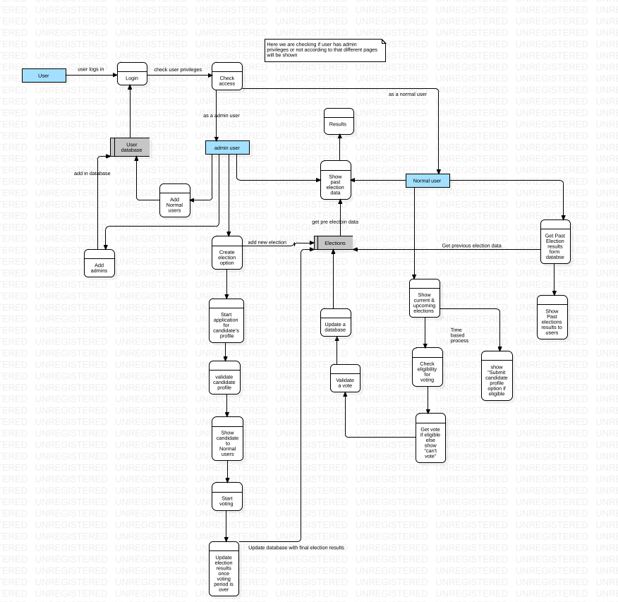

Slide 14
Tech Stack

Slide 15



Frontend
Backend
Evotekaro is a web application that uses React JS for the front end development,
Fast API for developing the web APIs and SQLite for the database.
The different python modules we have used for this project are:
Fastapi, uvicorn, sqlalchemy, passlib, bcrypt, python-jose and python-multipart.

Slide 16
Features

Slide 17
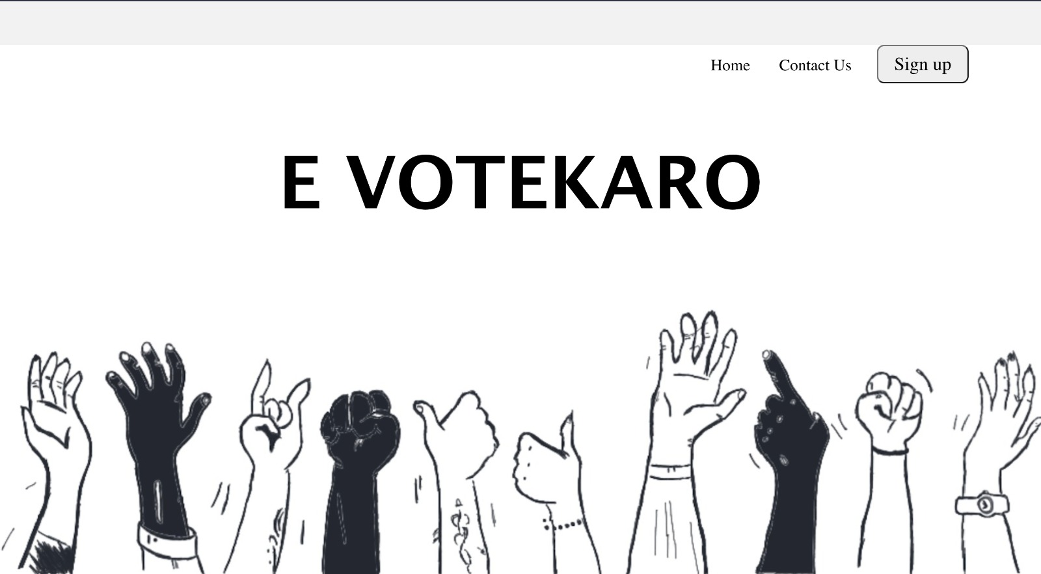
Landing page
User can sign in using their college email address and unique password
Using email address we r giving admin access.
If the email is not included in the database or the password is not correct the user won’t be able to sign.

Slide 18
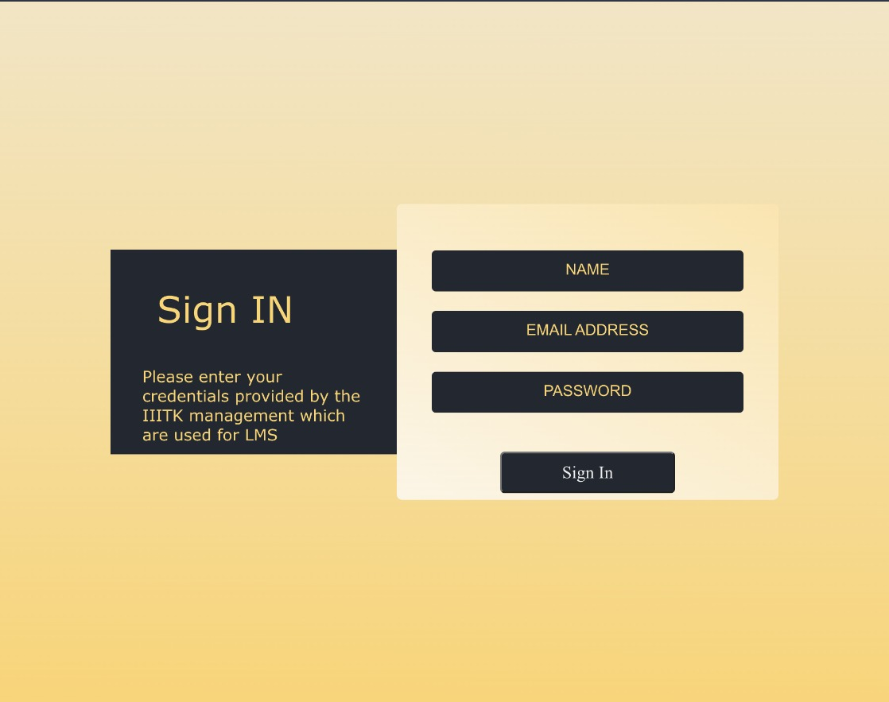
Sign In
After entering the credentials , the user is taken to admin interface if they have admin access or else they are routed to user interface.

Slide 19
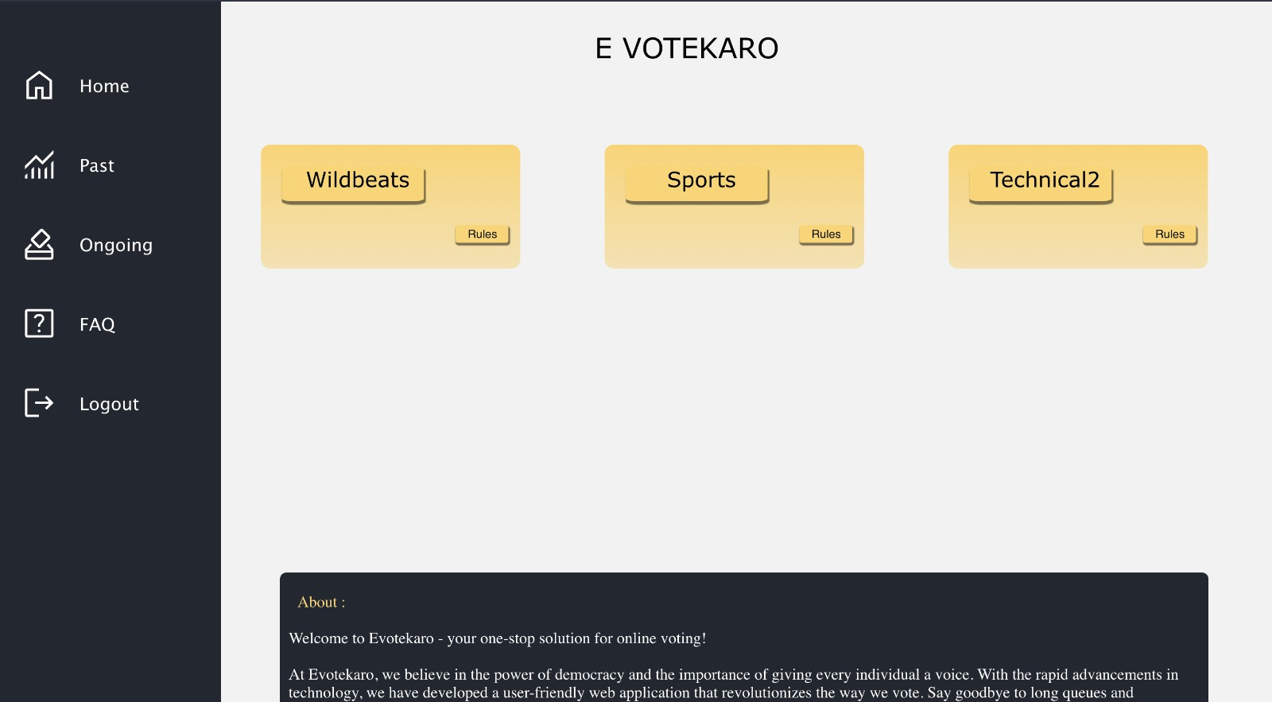
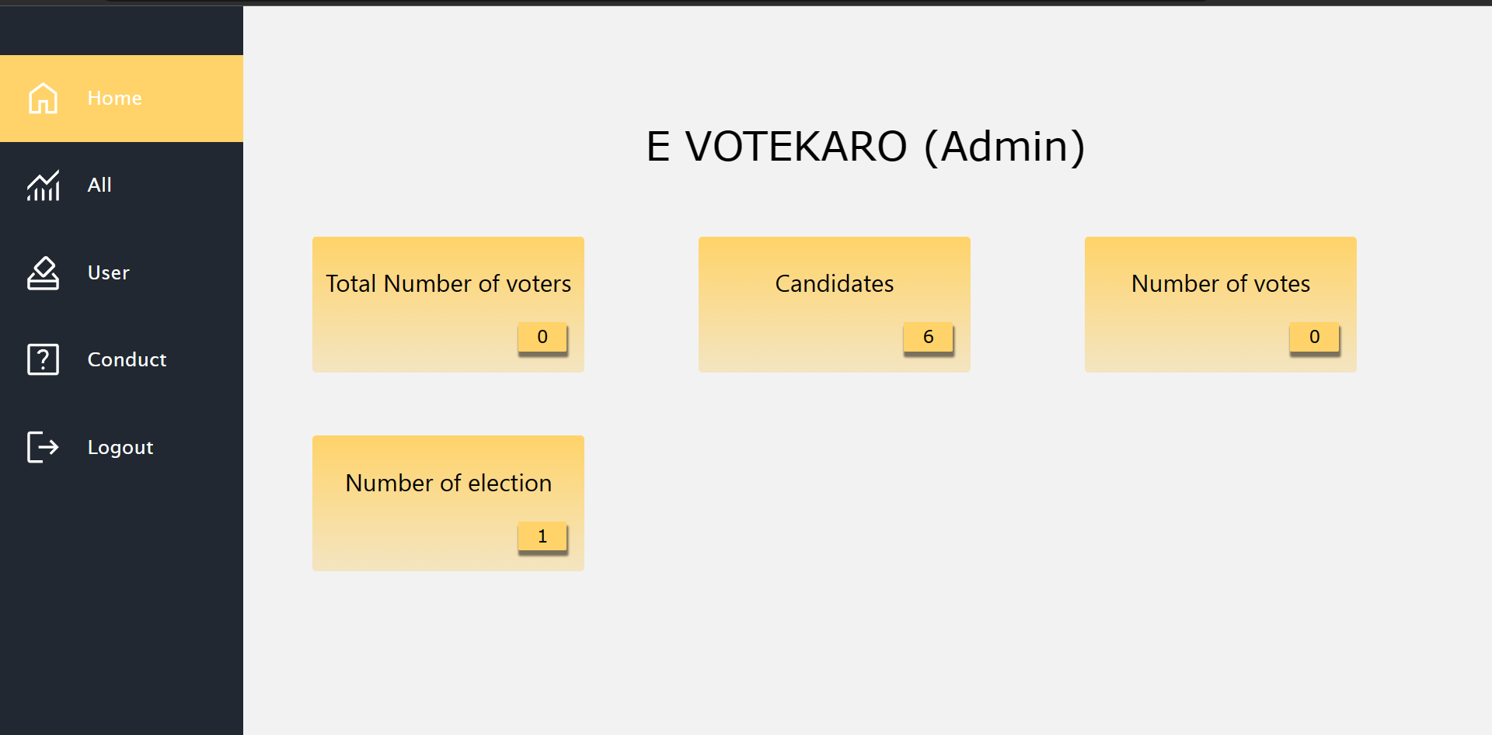
Interfaces
Voter Interface
Admin Interface
The user dashboard include , ongoing election, past election results , FAQ
The election is showed to voter only if they are eligible.
The admin dashboard contains home where they can see various information about website.
Admin can also add users by going to users page.
By going to conduct page admin can create elections .

Slide 20
User Interface
Home page
Voter can view the ongoing elections here only if they are eligible
The rules for each election is shown via the pop up

Slide 21
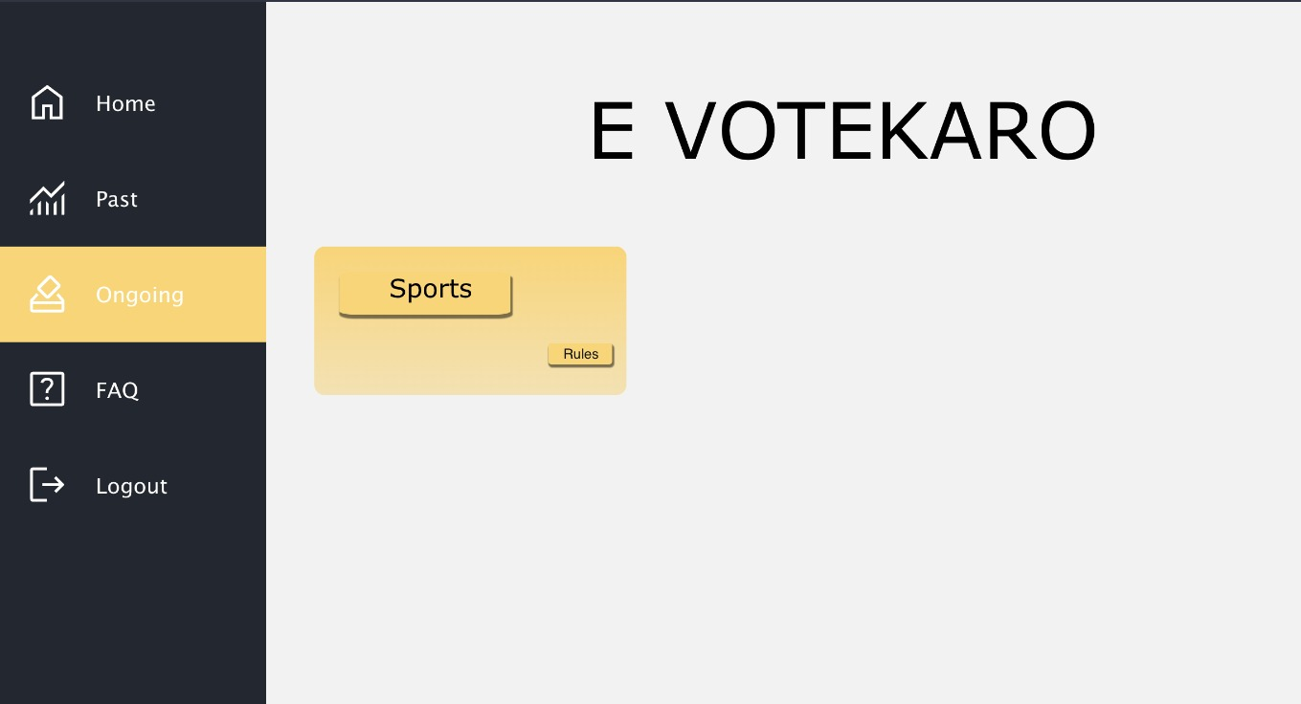
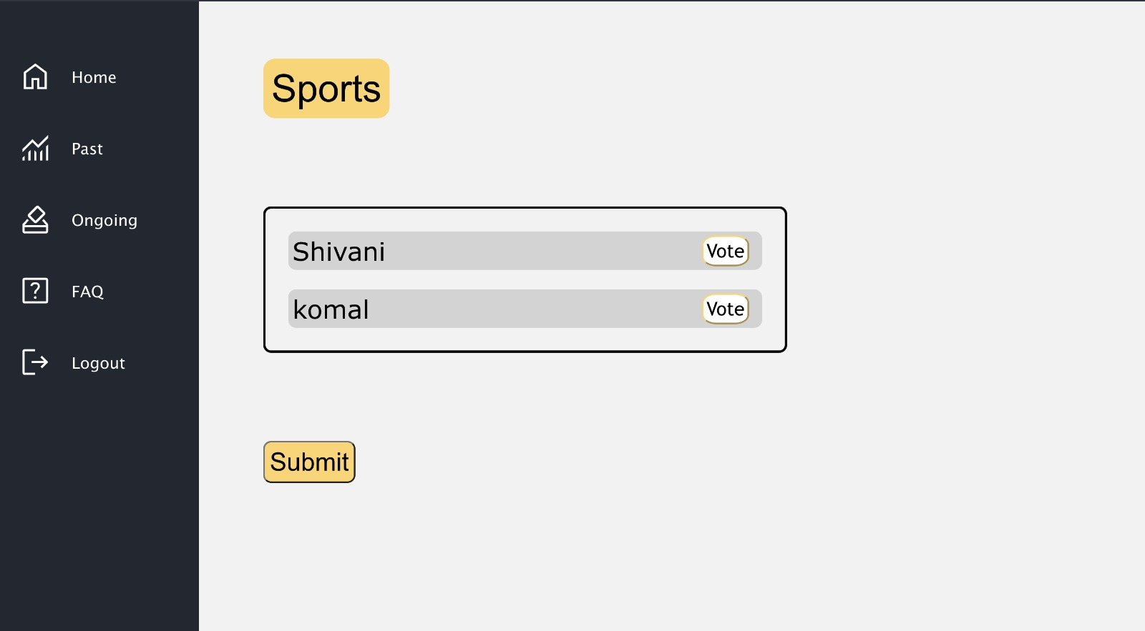
Ongoing Page
Same as home page here also the ongoing elections are shown
Rules are also shown via a pop up.

Slide 22
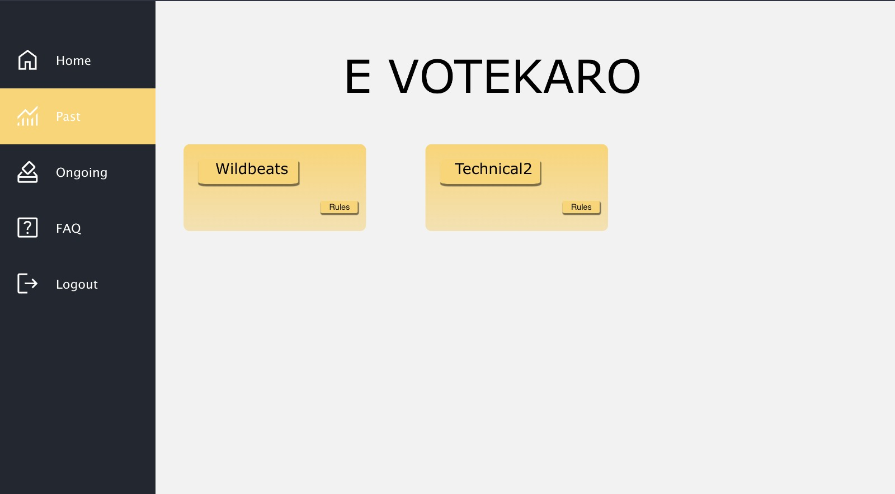
Past
The results of the past elections is shown here .
The elections results are shown according to the time.

Slide 23
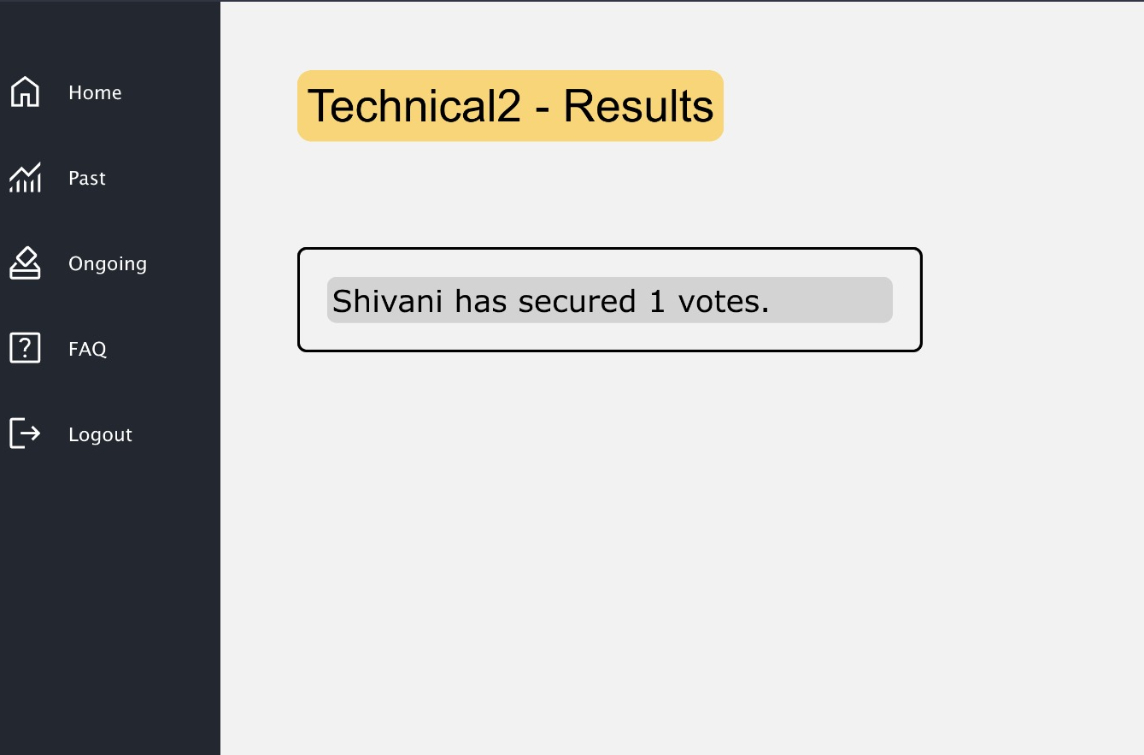
Results
The results of the prev elections is shown

Slide 24
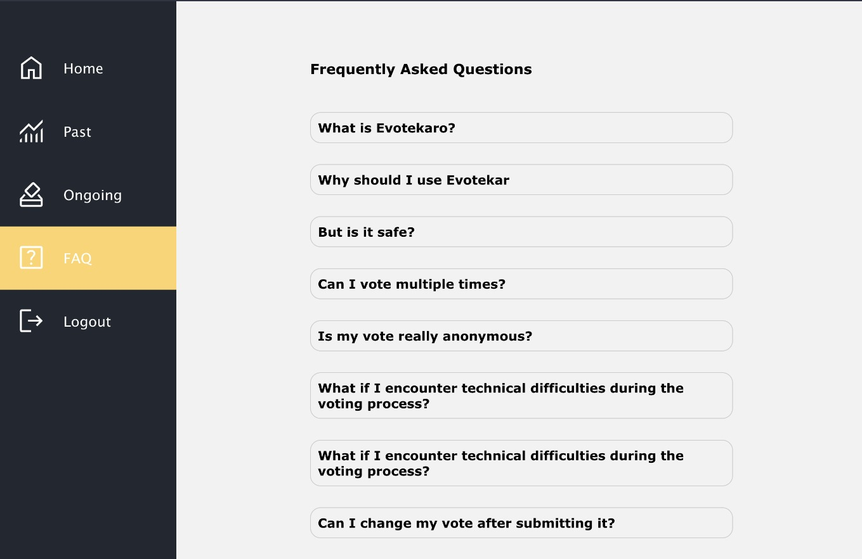
FAQ

Slide 25
Admin Interface
Home page
Admin can view No.of votes , Candidates , No.of votes, no. of elections

Slide 26
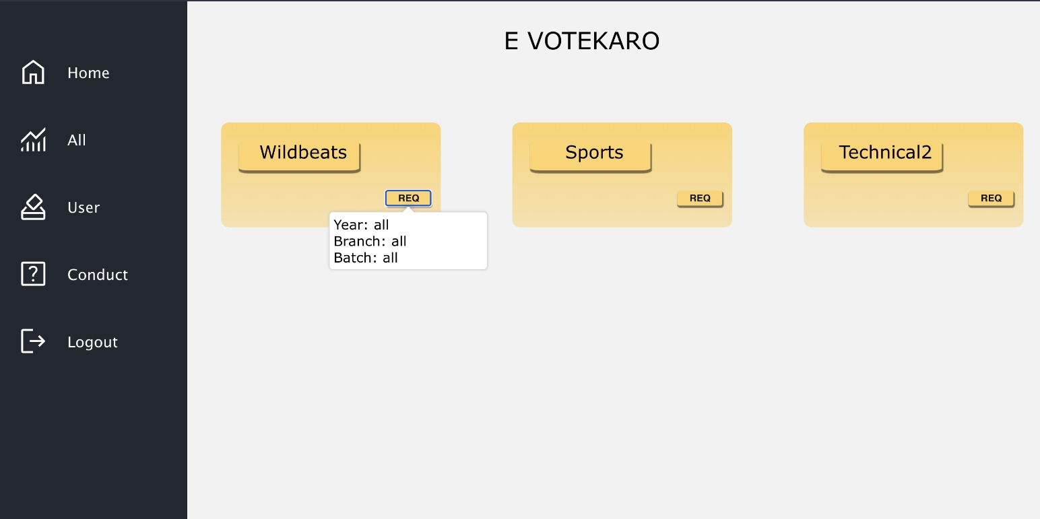
All elections
This is page is basically for the admin to check what are the basic rules for different kind of elections .

Slide 27
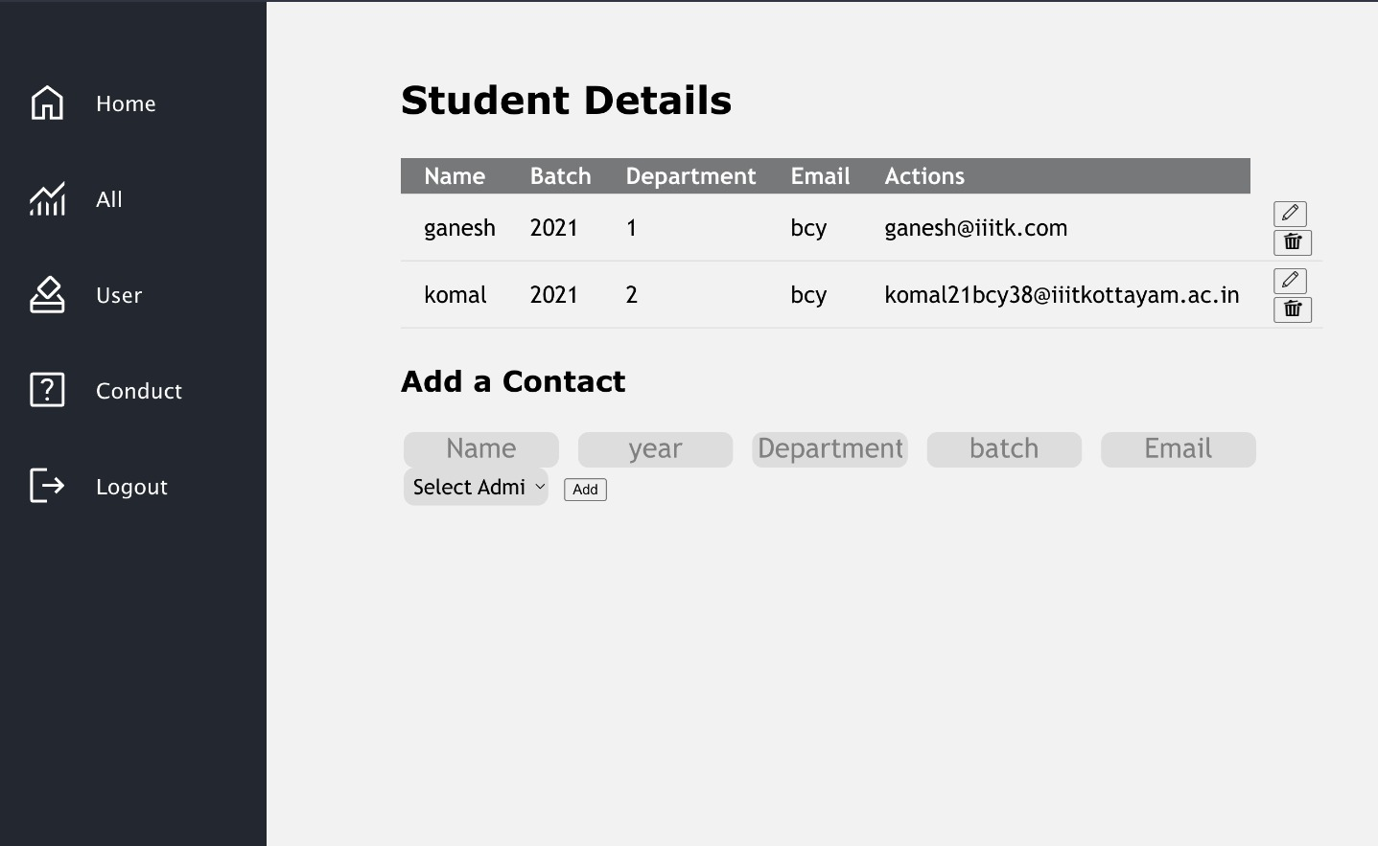
User
In this page admin can add data to the database.
A random unique password is generated for every added entry .
The email is sent to each new voter once they are added to database
The admin can also edit or delete the voters accordingly.

Slide 28
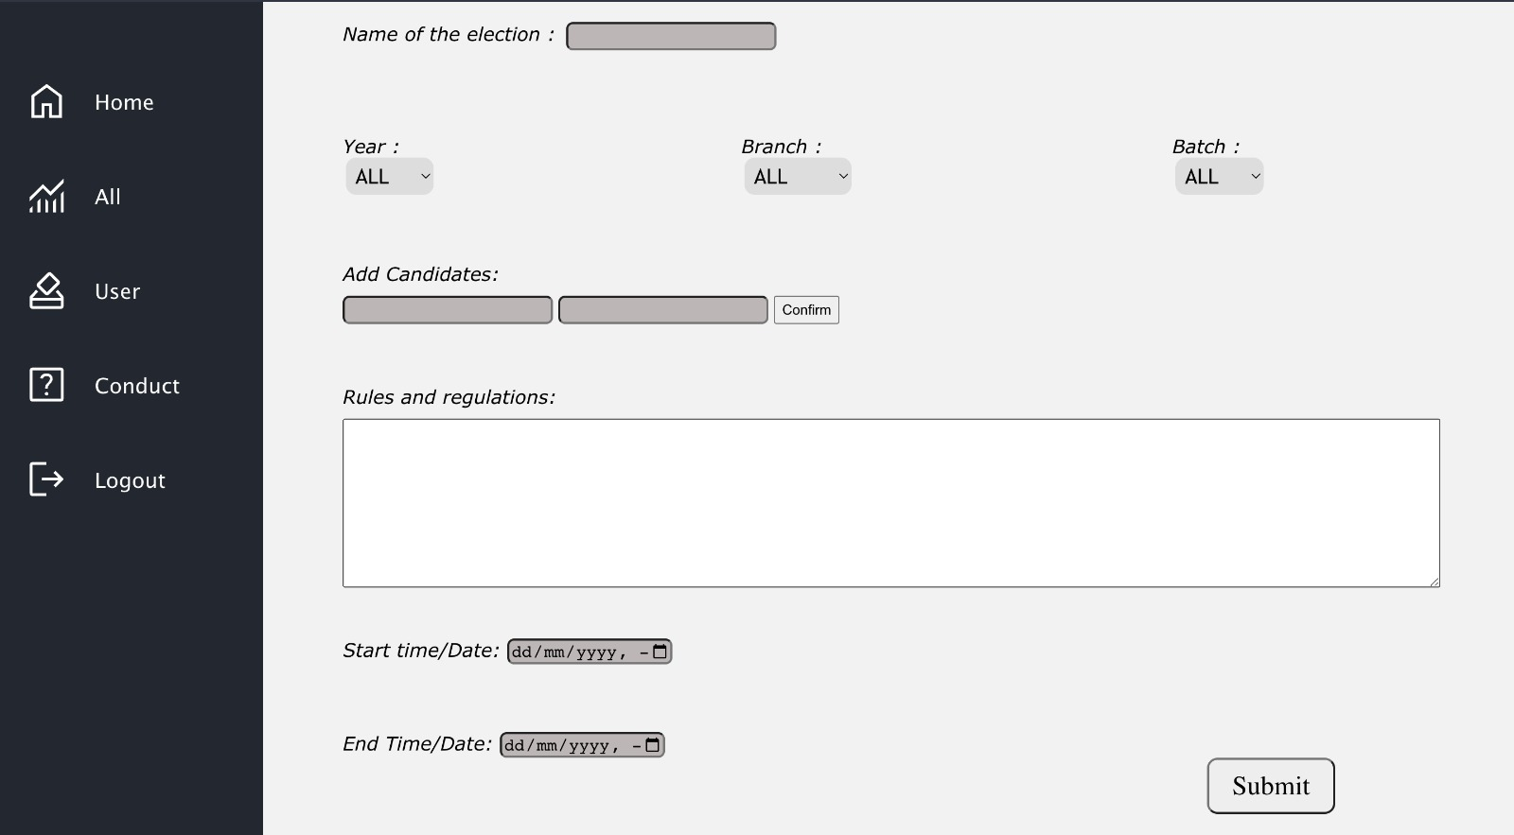
Conduct
the admin has access to conduct election.
They can put constraints on which batch , branch, year students are allowed to participate

Slide 29
TESTING
Test Document - Google Docs

Slide 30
CONCLUSION
In conclusion, Evotekaro, our innovative web application, has successfully addressed the challenges associated with casting votes and managing elections. By providing a user-friendly interface and robust functionality, Evotekaro has significantly improved the voting experience for users and streamlined the administrative tasks for election officials.
As we move forward, we remain committed to refining and expanding the capabilities of Evotekaro. By incorporating user feedback and leveraging emerging technologies, we will continue to enhance the application's usability, security, and reliability.

Slide 31
THANK YOU

